Slide 1
SmartArch - Security
February, 2015
This document is confidential and contains proprietary information, including trade secrets of CitiusTech. Neither the document nor any of the information contained in it may be reproduced or disclosed to any unauthorized person under any circumstances without the express written permission of CitiusTech.

Slide 2
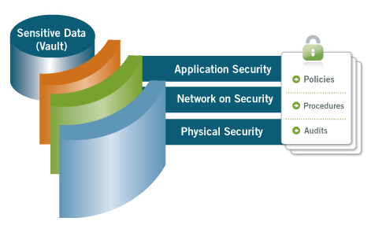
Defense in depth
Defense in depth is using multiple security counter measures to increase the security of the system as a whole.
If an attack causes one security mechanism to fail, other mechanisms may still provide the necessary security to protect the system.
Reduces the probability that the efforts of malicious hackers will succeed, minimizes the adverse impact and gives administrators and engineer’s time to deploy new or updated countermeasures to prevent recurrence.
Components of defense in depth include antivirus software, firewalls, anti-spyware programs, hierarchical passwords, intrusion detection and biometric verification.
Image Source: http://yodlee.com/security.html

Slide 3
STRIDE MODEL (1/2)
STRIDE is a classification scheme for identifying and categorizing the threats.
Threat | Definition | Example | Mitigation
Spoofing | An attacker tries to be something or someone he isn’t | Forging e-mail messages | Authentication
Tampering | An attacker tries to modify data that’s exchanged between the application and a legitimate user | Altering data during transit or at rest | Integrity
Repudiation | An attacker can perform an action with the application that is not attributable | Perform illegal operations in a system that lacks the ability to trace the prohibited operations. | Non repudiation
Information Disclosure | An attacker can read the private data that the application is transmitting or storing | Exposing information in error messages | Confidentiality
Denial of Service | An attacker can prevent your legitimate users from accessing the application or service | Flooding a network with SYN packets | Availability
Elevation of Privilege | An attacker is able to gain elevated access rights through unauthorized means | Obtaining administrator privileges illegitimately | Authorization

Slide 4



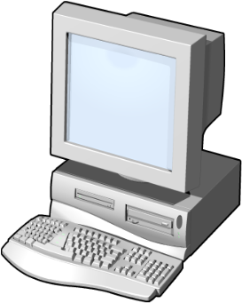
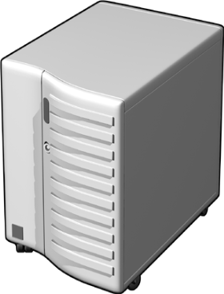


STRIDE MODEL (2/2)
Sample Mitigation Techniques
SSL/TLS
IPSec
RPC/DCO with Privacy
STRIDE
STRIDE
Configuration Data
STRIDE
Strong access control
Digital signatures
Auditing
Insecure Network
Authentication Data
Firewall
Limiting resource utilization for anonymous connections
STRIDE
Server
Client
Persistent Data
STRIDE
Source: http://download.microsoft.com/documents/uk/med/developerdave/en3.ppt

Slide 5
Threat modeling (1/2)
Threat modeling is a method to identify threats, the associated risks and determine the correct controls to produce effective countermeasures early in the SDLC.
Threat modeling is intended to be done at the design phase of a system, but it is usually implemented in the testing (vulnerability assessment) phase.
This assessment is done as an iterative process which comes in to picture when new modules are added in to the application.
Threat modeling can be applied to Networks, Web applications, Web servers, Web services, remote components and data stores.
The end result of this assessment is the security profile of that particular application under observation.
Threat Modeling Process
Identify Assets
1
Create an Architecture Overview
2
Decompose the Application
3
Identify the Threats
4
Document the Threats
5
Rate the Threats
6

Slide 6
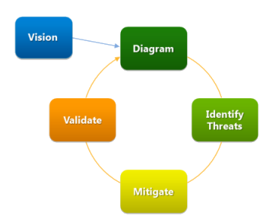
Threat modeling (2/2)
Threat Modeling Process Overview
Identify assets. Identify the valuable assets that your systems must protect.
Create an architecture overview. Use simple diagrams and tables to document the architecture of your application, including subsystems, trust boundaries, and data flow.
Decompose the application. Decompose the architecture of your application, including the underlying network and host infrastructure design, to create a security profile for the application. The aim of the security profile is to uncover vulnerabilities in the design, implementation, or deployment configuration of your application.
Identify the threats. Keeping the goals of an attacker in mind, and with knowledge of the architecture and potential vulnerabilities of your application, identify the threats that could affect the application.
Document the threats. Document each threat using a common threat template that defines a core set of attributes to capture for each threat.
Rate the threats. Rate the threats to prioritize and address the most significant threats first. These threats present the biggest risk. The rating process weighs the probability of the threat against damage that could result should an attack occur. It might turn out that certain threats do not warrant any action when you compare the risk posed by the threat with the resulting mitigation costs.
Microsoft’s SDL Threat Modeling Tool
The SDL Threat Modeling Tool enables any developer or software architect to
Communicate about the security design of their systems
Analyze those designs for potential security issues using a proven methodology
Suggest and manage mitigations for security issues
SDL Threat Modelling process
Source: http://www.microsoft.com/security/sdl/adopt/threatmodeling.aspx

Slide 7
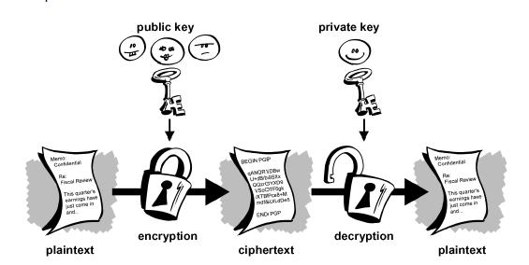
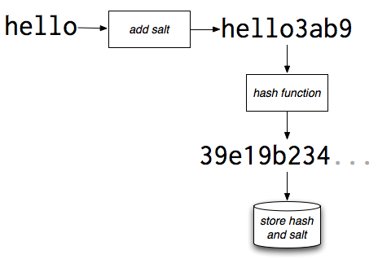
Encryption
The process of encoding information in such a way that only the person (or computer) with the key can decode it.
The primary purpose of encryption is to protect the confidentiality of digital data stored on computer systems or transmitted via the Internet or other computer networks.
Hashing
A hash value (or simply hash), also called a message digest, is a number generated from a string of text, by a formula in such a way that it is extremely unlikely that some other text will produce the same hash value.
Source: http://users.ece.cmu.edu/~adrian/630-f04/PGP-intro.html
http://blogs.quickheal.com/wp/how-does-a-hacker-crack-encrypted-password-databases/

Slide 8

HIPAA
HIPAA is the federal Health Insurance Portability and Accountability Act of 1996. The primary goal of the law is to make it easier for people to keep health insurance, protect the confidentiality and security of healthcare information and help the healthcare industry control administrative costs.
HIPAA protects an individual’s health information and his/her demographic information. This is called “protected health information” or “PHI”.
HIPAA defines information as protected health information if it contains the following information about the patient, the patient’s household members, or the patient’s employers:
Names
Dates relating to a patient , i.e. birthdates, dates of medical treatment, admission and discharge dates, and dates of death
Telephone numbers, addresses (including city, county, or zip code) fax numbers and other contact information
Social Security numbers
Medical records numbers
Photographs
Finger and voice prints
Any other unique identifying number
http://health.state.tn.us/hipaa/

Slide 9
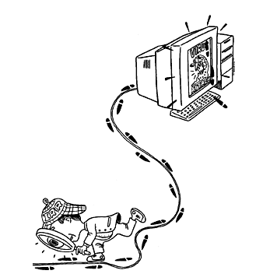
Computer Forensics:
Computer forensics is the application of investigation and analysis techniques to gather and preserve evidence from a particular computing device in a way that is suitable for presentation in a court of law.
The goal of computer forensics is to perform a structured investigation while maintaining a documented chain of evidence to find out exactly what happened on a computing device and who was responsible for it.
Investigators use a variety of techniques and proprietary software forensic applications to examine the copy, searching hidden folders and unallocated disk space for copies of deleted, encrypted, or damaged files.
Audit and Log requirements
An audit log is a document that records an event in an information technology (IT) system, often required as part of a compliance requirement..
In addition to documenting what resources were accessed, audit log entries usually include destination and source addresses, a timestamp and user login information.
Essentially an audit trail is intended to provide for accountability, non-repudiation and both of these as mentioned above are valuable among other things for their evidentiary value. Besides this however audit trails are also useful in identifying which parts of your system are most frequently used for instance or wherein the bottlenecks lie.
http://searchsecurity.techtarget.com/definition/computer-forensics
http://www.codesecurely.org/Wiki/view.aspx/Security_Code_Reviews/Logging__Auditing

Slide 10
Security Incidence and Response:
An information security incident should be considered an event that impacts the confidentiality, integrity, or availability of an information resource or asset
An act of responding to an action likely to lead to grave consequences especially in diplomatic matters
Ideally Incident Response would be a set of policies that allow an individual or individuals to react to an incident in an efficient and professional manner thereby decreasing the likelihood of grave consequences.
To successfully respond to incidents, you need to:
Minimize the number and severity of security incidents.
Assemble the core Computer Security Incident Response Team (CSIRT).
Define an incident response plan.
Contain the damage and minimize risks.
http://www.itpro.co.uk/security/20852/how-define-security-incident
https://technet.microsoft.com/en-us/library/cc700825.aspx

Slide 11
References
https://msdn.microsoft.com/en-us/library/ff648644.aspx
http://www.itpro.co.uk/security/20852/how-define-security-incident#ixzz3Qf3h8lkz

Slide 12
THANK YOU

